Slide 1
a)what is placenta accreta syndrome(PAS)?
b)what are risk factors?
c)how will you diagnose it ?
d)Management of PAS?
References:
1)Williams Obstetrics 26th edition
2)current progress in obstetrics and Gynecology by John Studd, Seang

Slide 2
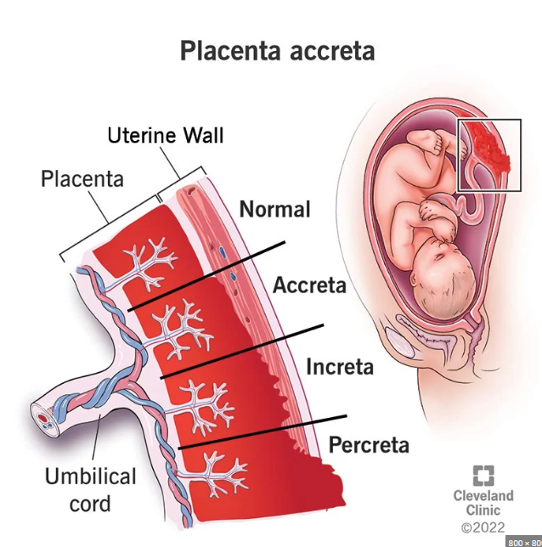
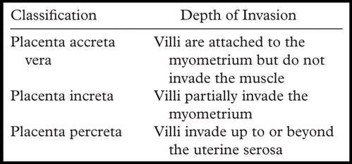
DEFINITION
ACCRETE SYNDROMES INCLUDE ANY PLACENTAL IMPLANTATION WITH ABNORMALLY FIRM ADHERENCE TO MYOMETRIUM BECAUSE OF PARTIAL OR TOTAL ABSENCE OF THE DECIDUA BASALIS AND IMPERFECT DEVELOPMENT OF NITABUCH LAYER.

Slide 3
RISK FACTORS-
1.Previous cesarean section
2.Placenta previa
3.Advanced maternal age
4.Multiparity
5.Previous myomectomy
6.Uterine curettage +/- Asherman syndrome
7.Submucous leiomyoma
8.Uterine anomalies
9.Smoking
10.Prior pelvic irradiation

Slide 4
Incidence - 1 in 533 deliveries.
Placenta previa has risk of accreta in 3%,11%,40% for 1st,2nd and 3rd repeat C-section respectively.
Placenta previa without uterine surgery has 1-5% risk of accreta.

Slide 5
Clinical presentation-
In 1st and 2nd trimester –usually present with hemorrhage as a consequence of coexisting placenta praevia
Accreta may not be identified in whom it is not associated with praevia. Antenatally – presence of risk factors should raise the suspicion.
1st trimester USG- with gestational sac in LUS ,irregular vascular spaces in placental bed, caesarean section scar implantation should be followedup.
Intra-operative-difficult/failed attempts at manual placental removal
Immediate postpartum-heavy bleeding from implantation site

Slide 6
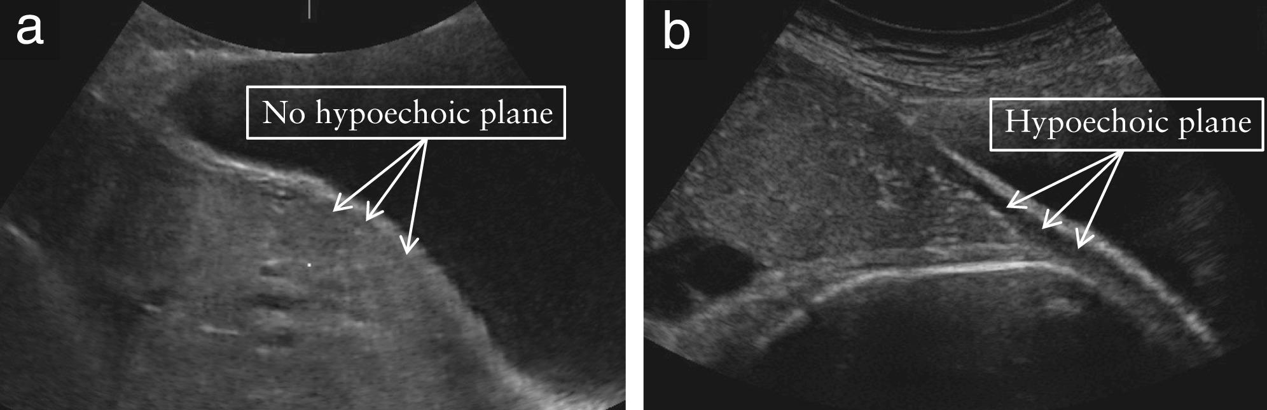
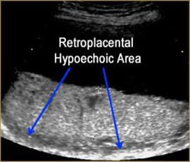
USG-
In 2nd ,3rd trimester-
1) loss of hypoechoic placental myometrial differentiation (retroplacental clear space)
2)Irregular shaped placenta lacunae(vascular spaces) within placenta -giving moth eaten /swiss cheese appearance
3) Thinning of myometrium (<1mm)
4)Protrusion of placenta into urinary bladder

Slide 7
COLOUR DOPPLER-
1)Diffuse of focal turbulent lacunar flow
2)Vascular lakes with turbulent flow
3)Hypervascularity of serosa-urinary bladder interface
4)Blood vessels or placental tissue bridging uterine-placental margin, myometrial bladder interface or crossing uterine serosa.

Slide 8
3D POWER DOPPLER-
1)Hypervascularity
2)Numerous coherent vessels involving whole uterine serosa-bladder junction
3)Inseparable cotyledonal and intervillous circulations, chaotic branching,detour vessels

Slide 9
MRI-T2 weighted images-
1)Uterine bulging
2)Heterogeneous signal intensity
3)Dark intra-placental beds
4)Tenting of bladder
5)Direct visualisation of invasion of adjacent organs
6)Loss of myometrial trilaminate structures

Slide 10
BIOCHEMICAL MARKERS-
Raised MSAFP has association >2.5mom -eight fold increased risk of association
Raised bhcg >2.5mom has four fold increased risk of association
Raised Maternal serum Creatinine Kinase associated with increta and percreta

Slide 11
MANAGEMENT-
*Confirm diagnosis
*To be shifted to a tertiary care hospital with all facilities
*Plan and counsel the patient regarding need for blood ,blood products,
*Assemble Multi-disciplinary team
*Preoperative investigations-blood group, blood tests, cross-match,coagulation profile
*Timing of Surgery - after 34 weeks -ideally around 36weeks

Slide 12
PRE AND OPERATIVE SPECIFICS-
*Balloon catheterization of - Uterine or Internal Iliac artery
*Cystoscopy- with ureteric stenting avoids ureteral injury in cases with increta
*Pre-op USG mapping of placenta
*Anaesthesia-General anaesthesia better
*Skin Incision-midline vertical incision better to have better exposure
*Uterine incision-Classical / Upper transverse incision avoiding placenta

Slide 13
SURGERY-
Planned preterm Cesarean hysterectomy- better
Individualised decision has to be made-based on-
1.desire for future fertility
2.Hemodynamic stability
3.Extent of invasion
4.Availability of resources

Slide 14
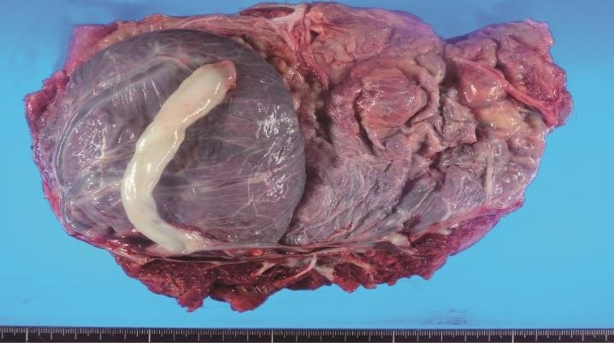
SURGICAL OPTIONS-
1)Radical cesarean hysterectomy- reduction of maternal mortality to <2%
2)Uterine Sparing -extirpative method, local resection , conservative method
a)Extirpative method-forceful removal of placenta
b)Local resection (3P’s)-preop mapping of placenta, pelvic devascularisation, placenta non removal with excision along the myometrial attachment.
Hemostatic measures –uterine or internal iliac artery ligation, embolization,compression square sutures, B-lynch sutures is needed .

Slide 15
Conservative method-
umbilical cord is cut near placental surface(2-3cm) and left in situ
Done in patients - who desire future fertility
-In extremely unresectable percreta
-situations of undiagnosed accreta without proper resources
Prerequisites- hemodynamic stability
-Normal coagulation status
- Patient awareness and acceptance of risks

Slide 16
CONSERVATIVE-
Post-op - Wait for spontaneous resorption
-Prophylactic antibiotics
- Uterotonics
+/- Adjuvant-Methotrexate 1 mg/kg on alternate days for 4-6days (controversial)
Followup - for 1-12months with USG,bhcg has to be done
-look for signs of sepsis ,hemorrhage,DIC.

